Slide 1
Valuation and Scenario Analysis
Chapter 10

Slide 2
Valuation vs. Scenario Analysis
In valuation, we are interested in the present value of future cash flows
In scenario analysis, we are interested in the range of situations that might exist at a future time

Slide 3
Example
One-year European call option on a stock worth $50 with a strike price of $55
The value might be calculated as $4.5 and it might be sold for $5
But a scenario analysis might show there is a 5% chance of the stock price rising above $80
This would cost the seller about $20

Slide 4
Volatility and Asset Prices
If the average return from an asset is μ and its volatility is σ then the most popular model (known as geometric Brownian) motion gives
where S_{T} is the stock price at time T and φ(m,v) is a normal distribution with mean m and variance v.

Slide 5
Probability of Extreme Values

Slide 6
Risk-Neutral Valuation (pages 219-224)
In a risk-neutral world investors do not require an extra expected return for bearing risks
If when valuing derivatives we assume that the world is risk-neutral, we get the right valuation for the real world (where investors do require an extra return for bearing risks) as well as for the risk-neutral world

Slide 7
Applying Risk-Neutral Valuation to Value a European Stock Option
1. Assume that the expected return from the stock is the risk-free rate
2. Calculate the expected payoff from the option
3. Discount at the risk-free rate

Slide 8
Valuing a Forward Contract with Risk-Neutral Valuation
Payoff is S_{T} – K
Expected payoff in a risk-neutral world is S₀e^{rT} – K
Present value of expected payoff is
e^{−rT}[S₀e^{rT} – K] = S₀ – Ke^{−rT}

Slide 9
Valuing a Binary Option with Risk-Neutral Valuation
Consider a binary option that pays off $100 if the stock price at time T is greater than V
The value of the binary option is 100e^{−rT}N(d₂) where r is the risk-free rate (assumed constant) and N(d₂) is the probability that the stock price is greater than V in a risk-neutral world

Slide 10
Black-Scholes-Merton
where c is the value of a European call option, p is the value of a European put option, K is the strike price and denotes expected value in a risk-neutral world

Slide 11
Discrete Outcomes (pages 222-223)
Suppose that a variable can take n different values
Define π_{i} as the value of a derivative that pays off $1 if the ith outcome occurs
When applying risk-neutral valuation we set the risk-neutral probability of the ith outcome equal to

Slide 12
Default Probabilities
Risk-neutral default probabilities can be implied from bond prices or credit spreads.
They are greater than real-world default probabilities

Slide 13
Girsanov’s Theorem (page 224)
For valuation we work in the risk-neutral world
For scenario analysis we work in the real world
Girsanov’s theorem shows that when we move from one world to the other expected returns change but volatilities stay the same

Slide 14
Why Both the Real and Risk-Neutral Worlds Can Be Relevant for Scenario Analysis
In a scenario analysis we should
  Randomly sample paths followed by market variables out to the time horizon
  Value the portfolio using risk-neutral valuation at the time horizon for each sample

Slide 15
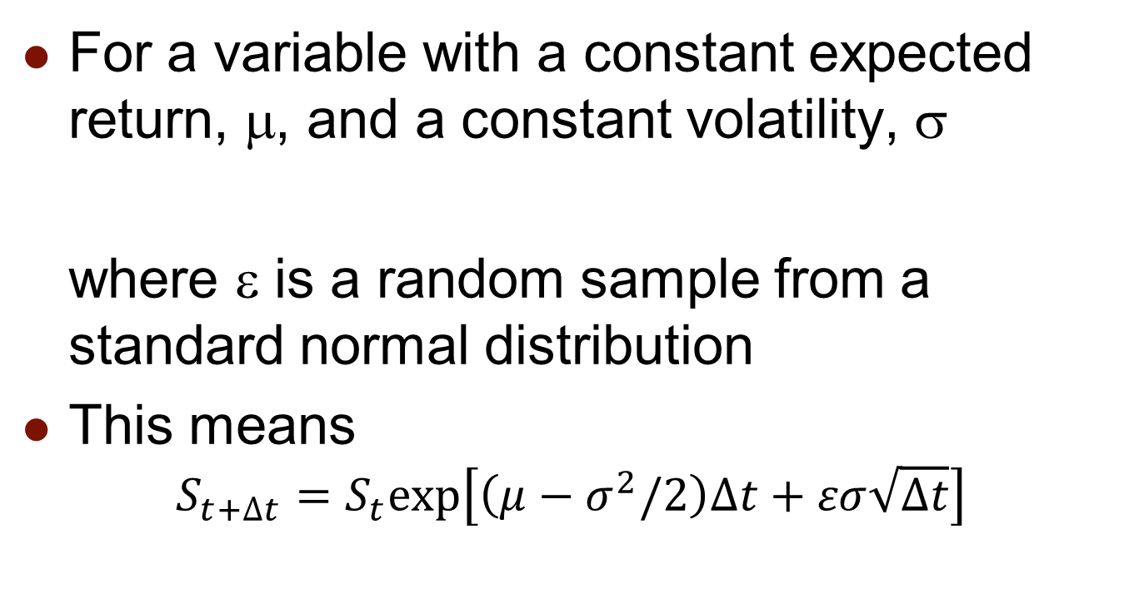
A Simple Model
For a variable with a constant expected return, μ, and a constant volatility, σ
where ε is a random sample from a standard normal distribution
This means
$$S_{t+∆t}=S_{t}exp\left[\left(μ−σ^{2}/2\right)∆t+εσ\sqrt{∆t}\right]$$

Slide 16
Mean Reversion
Interest rate, volatilities, and some commodity prices follow mean reverting processes where they are pulled back to a long run average value
Superimposed on the pull is a random change

Slide 17
Determining Real World Processes
To determine real world processes from risk-neutral processes for a variable we can use CAPM to adjust the expected return
If σ is the volatility of the variable, σ_{M} is the volatility of an index of market returns, ρ is the correlation between percentage changes in the variable and percentage changes in the market index, then we should increase the expected return by λσ where

Slide 18
Example
If a commodity is uncorrelated with the return on a market index its expected return should be the same in both worlds
But if ρ = 0.3, σ = 40%, σ_{Μ} = 20%, and the excess return of the market over the risk-free rate is 6%, then λ=0.09 and the expected return should be 3.6% higher in the real world than the risk-neutral world

